Slide 1
The Singing
Guru
By Kamla Kapur

Slide 2
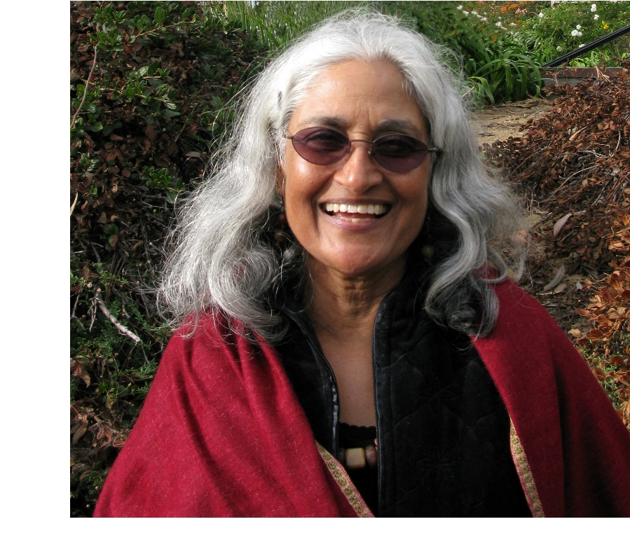
Author
Kamla Kapur – poet, writer, playwriter
Inspired by stories heard as a child
Found solace and healing in Kirtan at times of hardship – husbands suicide
Led to the writing of the book

Slide 3
Plot/ SToryline
Part 1
Bhai Mardana Ji, very quickly, turning into goat
  Other goats - part fiction – believable?
Used as a bridge/ portal to access other historical events
Part 2
The set up of Kartarpur Sahib
The introduction of Bhai Lehna Ji.
Part fiction/ based on true story – artistic liberty vs. inaccurate?

Slide 4
Moral Lessons/stories
Initial desire led to dehumanisation/ entrapment by Maya/ witches
Kauda Rakshash – Mardana was trapped in a gold cage, trapped by his own desire
Naam, contentment,
True Langar – Mehta Kallu slapped Guru Nanak Dev Ji
“To separate God from life is ignorance and duality.”
The journey in the river – the true Nature of Akaal Purkh
The glance of the Guru is enough to save you – thugs – pg72
Sajjan Thag – ‘’Ujal kaiha chilkana, Ghotim kaalari mas’’
‘’Stay above good and bad, Mardana. They are the same.’’ pg 90
Salis Rai and the ‘stone’ – only the Guru can make you see the True stone.
There are many levels to Nur Shah’s illusion – Maya has many tricks
‘’To say I am God, smacks of pride’’ thought Mardana pg 189

Slide 5
themes
Goat and imminent death – a metaphor for us; we are bound by Maya (witches) and end up being trapped ready to die.
‘’Baba’s deep, resonant voice began with the note sa. If God has a sound, it must be sa.’’ ‘’The steady drone of Being, sa and pa, emanated from the bubbling river’’
  The sound is Anahad – the air from which is travels is the Guru – Pavan Guru
  The lives of many were changed by Guru’s singing. What did they sound like?
Bhai Mardana Ji – struggles with his own mind but, through the Guru, one can become divine

Slide 6
Characters
Bhai Mardana Ji
  Did he develop?
  Family (fiction)
  Realistic? Controversies? Should he have been portrayed the ‘perfect Sikh?’
  “Mardana is me” says Kamla Kapur. He represents the reader seeking Guru Nanak Dev Ji.
Guru Nanak Dev Ji (Baba)
  Portrayed as you expected?
Other goats
  Added to the story?
Part 2 – Baba Buddha Ji, Bhai Lehna Ji
  Portrayed as you expected?

Slide 7
Favourite Passages
‘’Bhugat Gian’’ Mardana scoffed. For food, wisdom’’ pg 9
‘’I give you the most precious jewel in the whole world.’’ ‘’whispered, ‘’Wah~hay~guru.’’
  Did you hear it being said? Who was the voice you heard? Was it Guru Nanak Dev ji? Pg 36
‘’A holy man should never dream of marrying! I have been chaste.’’ ‘’Then how come you’re a goat?’’ Taakat asked. Pg 47
‘’A muslim cap, but the costume of a hindu yogi. What religion are you?’’ pg 68
‘’Death was about to drag him away. Angels appeared and demanded the dead mans soul’’ ‘’Baba Nanak glanced his way, and that is enough to redeem him.’’ pg 72
‘’what shall I do with my mind after I harness it?’’ ‘’Give it away’’ pg155

