Slide 1
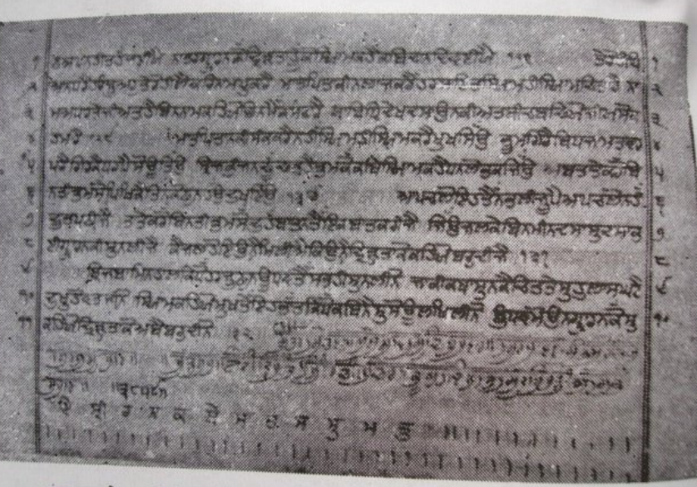
Sri Charitropakhyan
An Analysis of the writings of Guru Gobind Singh Ji
Prabhjot Singh

Slide 2
Ground Rules
1. Punctual attendance
2. The whole book/article of the month must be read
3. Come with an open mind
4. Share your learning and listen to others
5. Keep the discussion relevant
6. Respect each others’ confidentiality

Slide 3
History of Sri Charitropakhyan
Completed at Anandpur Sahib in 1753
Characters from Mahabarat, Puranas, Brihat Katha, Saritsagar Kath, Alif Laila etc
Stories from a wide range of people in society (kings to sadhus to prostitutes)
Each story has a moral message
Provide awareness of social pain, criminal mentality and exploitation that arises from intense lust
Holds male society to account
Interesting that many in the Panth feel this Bani should be separated for the 'good of the sangat' because of its content

Slide 4
Chandi Charitar (The first Charitar)
Description of Chandi as the force of Akal Purakh which has been active in destroying impious forces
Force is the sword & blade
Introduces the concept of 'Baala' which takes the positon of 'Kaur'
  One of pure chastity
Chandi - the source of creation
Devi - force of Maya
  In the form of a cultured & virtuous woman, but also with deadly weapons
  Performs actions as per the Hukam of Akaal Purakh
  Therefore distinct from the Devi that is worshipped as the wife of Devtas in other traditions
Encompases many other characters (Narsingh, Ram, Krishna Avtar)

Slide 5
Chandi Charitar (The first Charitar)
Baala
  Comparable to Kaur (one of pure chastity)
  Soul bride to the Husband (Akaal Purakh)
  Male & female union of unlimited purity, unparalleled and inseparable
Vishnu rests on the bed of Shesh-Naag's coil
  Encompases lion-riding Durga
  Encompases Usha (highly virtuous woman who has the capacity to destroy darkness)
  Similarities to Akaal Ustat where Waheguru is described as diversified in various forms of Devi
Essentially all descriptions of the forms of Akaal Purakh

Slide 6
Female complexity
The real image of females is corrupted by pleasure-seeking male forces
In her true form, she is an active force capable of eradicating all crimes & evils from the world
Social structure
  Gives her equal opportunities
  But also treats her like an object of desire & confines her to the house
  Provokes a destructive form; capable of destroying society whilst reamining sidelined
  It is up to male society to choose the road of progression, to use her peerless strength for growth & betterment of humanity
Indra vs Kaali

Slide 7
Summary of Charitars 2-16; a treatise on ethics
When in power, the ruling faction forgets its responsibility and engages in immoral acts
Innocent people are forced onto the battlefield and humanity suffers
Using wealth/power as influences to establish illicit relations will have devastating consequences
Decisions made by people who are sexually engrossed affect their own family directly & most potently
As a result of male excesses, females can be driven towards wrong-doings and project an illusion of impurity within society
It is the duty of advisors to bring an astray ruler back on track

Slide 8
Summary of Charitars 2-16; a treatise on ethics
The perverted mentality of people impersonating as Saints or Yogis
These events are prevalent in every social order and every city
Immoral people not only enter religious places but also deceive the innocent spiritual seekers
Highlights the potential for prostitues in poor economic situations to become women of high moral character
Whenever prestige and faith are at stake, one should always defend the faith & religious duty

Slide 9
Analysis of Charitars 21-23 Anoop Kaur
The dangers of neglecting the pious relationship between a Sikh and the Guru
Sexually obsessed people twist the meanings of religious texts to uphold their actions
Adultery is a sure invitation of death & devastation
The importance of ensuring that even these people are looked after if they see the error of their ways

Slide 10
Messages of Charitars 25-403
It is important to look after your household rather than only sitting in places of worship all the time
Guru Ji describes situations where the wife has guided the husband back onto the correct path (80)
Repudiation of magic mantras & sorcery (119)
  Irony that critics of this Baani associate it as being influenced by group that the Guru is Himself criticising
Repudiation of idol worship (266)
In some stories, Guru Ji has attached himself as the protagonist to try to convey te message that attacks of Kaam happen on men of God and they are able to successfully destroy these attacks with superior intellect and spirituality

Slide 11
Charitar 404 Sri Sabudh Baach
When wise people present before society the dangers of crimes relating to Kaam, people become prudent
This charitars aims to uproot discrimination in society
The birth of Baala emerging from the fire of battle, untameable
  Form of Maha-Chandi
  Only objective to become one with the Lord of the Universe which is possible when lustful tendences get destroyed from the breath of society
  Reappears as Bhawani
Guru Gobind Singh Ji's criticism of forcible conversions and implicit conversion tactics

