Slide 1
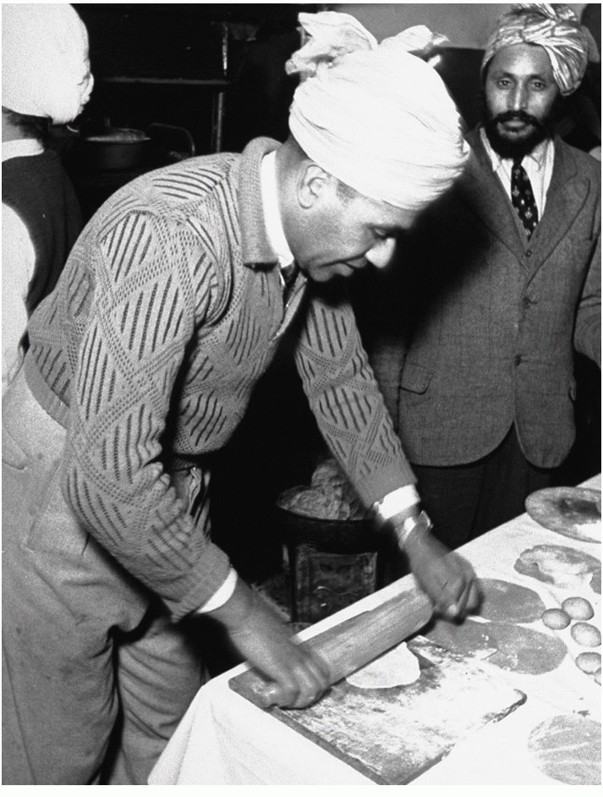
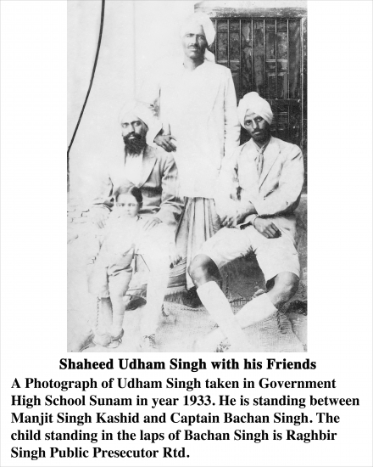

Slide 2
Overview of the book
To publicize some significant facts about Udham Singh's life
To foster appreciation for his personality by laymen and historians
Oral evidence from those who knew him i.e. Swaran Singh and Inder Singh who cooperated enthusiastically with the authors
Archived material (National archives of India) and a personal collection of documents from Shiv Singh Johal
  Documents ended up with Guru Nanak University after an employee of the Indian Administrative Service arranged for them to go there

Slide 3
Bhai Udham Singh
Born as Sher Singh in approx December 1899
Father worked as a railway crossing watchman and died when Udham Singh was young
Bereft of relatives, no mention of mother
Lived in Amritsar Central Khalsa orphanage from 1907 until 1919
Stayed in America working for Ghadarites
  Driving revolutionaries from port to meeting points
  Acted in 2 Hollywood films that included Elephant Boy (1937) and The Four Feathers (1939)
Possibly received a message from Bhagat Singh asking him to return to India
  Subsequently arrested with weapons and jailed for 4 years
Travelled to Kashmir aged 30 disguised as a Sadhu
  Noted to be confident and charming, well versed in English
  Arrested and then released during his stay for being implicated in the Gurdaspur conspiracy

Slide 4
Bhai Udham Singh cont.
Well versed in poetry
Fervent admirer of Bhagat Singh 'his Guru'
Went to England by 1934 with no intention of returning
  Possibly supported himself by pedalling
Confided to Shiv Singh that he was planning something several months ahead of the killing of O'Dwyer
Went quieter in 1940
Enquiries made in 1940 about which 'brothers or relations' of his were killed in the massacre

Slide 5
Incarceration
Signs himself as Mohamed Singh Azad despite everyone knowing his real name
Attempted to protect Shiv Singh Johal by indicating he doesn't know his name
Possibly requested weapons, coded as books in his letters
Retains his sense of humour in his letters
  Talks about a chaplain wasting everyone's time in an attempt to get him to convert to Christianity
  Refers to the Lord Chamberlain as Mrs Chamberlain
Uses very good English in some phrases and disguises his real requests in phrases with broken English
Repeatedly denied his requests for books and Sikh chaplaincy support

Slide 6
Legacy
Ashes eventually returned to India and met with a hero's welcome
A charity dedicated to Singh operates on Soho Road, Birmingham.
A museum dedicated to Singh is located in Amritsar, near Jallianwala Bagh.
Singh's weapon, a knife, his diary, and a bullet from the shooting are kept in the Black Museum of Scotland Yard.
Singh has been the subject of a number of films: Jallian Wala Bagh (1977), Shaheed Uddham Singh (1977), and Shaheed Uddham Singh (2000).
Udham Singh Nagar district in Uttarakhand is named after him
Shaheed Udham Singh Chowk in Anupgarh
The day of his death is a public holiday in Punjab and Haryana.
A statue of him was installed at the Jallianwala Bagh, Amritsar in March 2018

