Slide 1
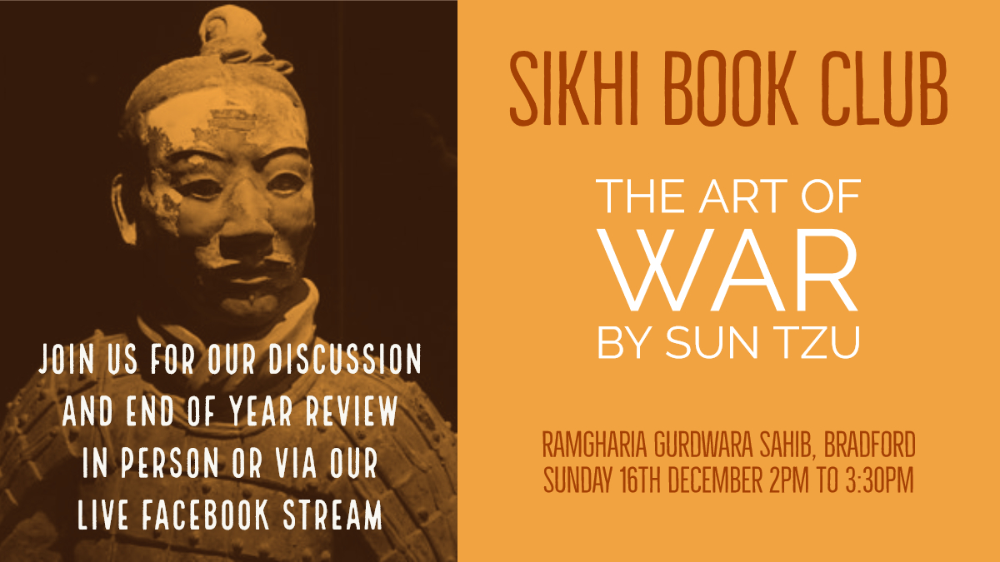

Slide 2
Ground Rules
1. Punctual attendance
2. The whole book/article of the month must be read
3. Come with an open mind
4. Share your learning and listen to others
5. Keep the discussion relevant
6. Respect each others’ confidentiality

Slide 3
Introduction
771 to 476 BC
The less needed war is the better
Prevention is key but this requires knowledge and solutions to the problems
The Art of War as a war against war
Buddhists watching rotten corpses by way of removing greed
Complete ruthlessness
  The universe is inhumane

Slide 4
Strategic assessments
The way, weather, terrain, leadership and management
When the way is righteous, people think little of dying for it
Qualities of leadership
The art of deception regarding competence
Provoke the enemy by stirring up anger to make them forget their strategy
Importance of planning: victorious warriors win before fighting

Slide 5
Doing Battle (any kind of advancement)
Focuses on winning without conflict
Should be done quickly and without ego
In order to utilise the advantages of weapons you must know the disadvantages
Practical aspects of war (food and provisions)
Importance of fighting for rewards
Use the enemy to defeat the enemy

Slide 6
Planning a siege & Formation
Scheming is best of all > attacking alliances > attacking an army
Surround the enemy if you outnumber them
  Attack if 5:1
  Divide if 2:1
Issues with good leadership (civil and military)
The importance of knowing when not to fight
Knowing yourself and others
What everyone knows is not called wisdom

Slide 7
Force, Emptiness & Fullness
Tao principles: each force contains within it a bit of its opposite
Imagination/creativity paired with solid knowledge
Unorthodox and orthodox measures in variation
Need complete order to create disorder
  Need complete bravery to fake cowardice
The power of the force of momentum in allowing everyone to have a use no matter how timid
Good warriors cause the enemy to come to them
Signals and information about strategy must be secure and confusing to the enemy

Slide 8
Armed Struggle (direct conflict)
Understand how to tip the balance in your favour
Know the distances and terrain involved
The situations in which it is advantageous to divide an army
Be capable of firmness in your own heart
Advice on predicting ambushes
Don't attack an army on the way home

Slide 9
Adaptations, Maneuvers & Terrain
Consider benefit and harm of all actions
5 dangerous traits of generals
  ready to die, intent on living, quick to anger, puritanical, those who love people
  A good general is not committed to death but doesn't expect to live
Advice to avoid water
How to interpret the attitudes of emissaries (and the location of birds)
6 causes of defeat

Slide 10
Nine Grounds
Take away the opponent's foresight, preparedness, caution and time
Assess for vulnerable spots
Being in mortal danger focuses the mind of all
Making a military force like a snake
Qualities of a general
  Secretive, fair, orderly
  Keeps soldiers unaware when needed

Slide 11
Fire Attack & On the use of spies
The uses of fire and water in contending with an opponent
Anger should not be used to mobilise an army
  The dead cannot be restored to life
  Only act if beneficial
Reward intelligence and foreknowledge
5 different types of spies
Spies as an essential part of warfare
All wars are ultimately wars of information

