Slide 1
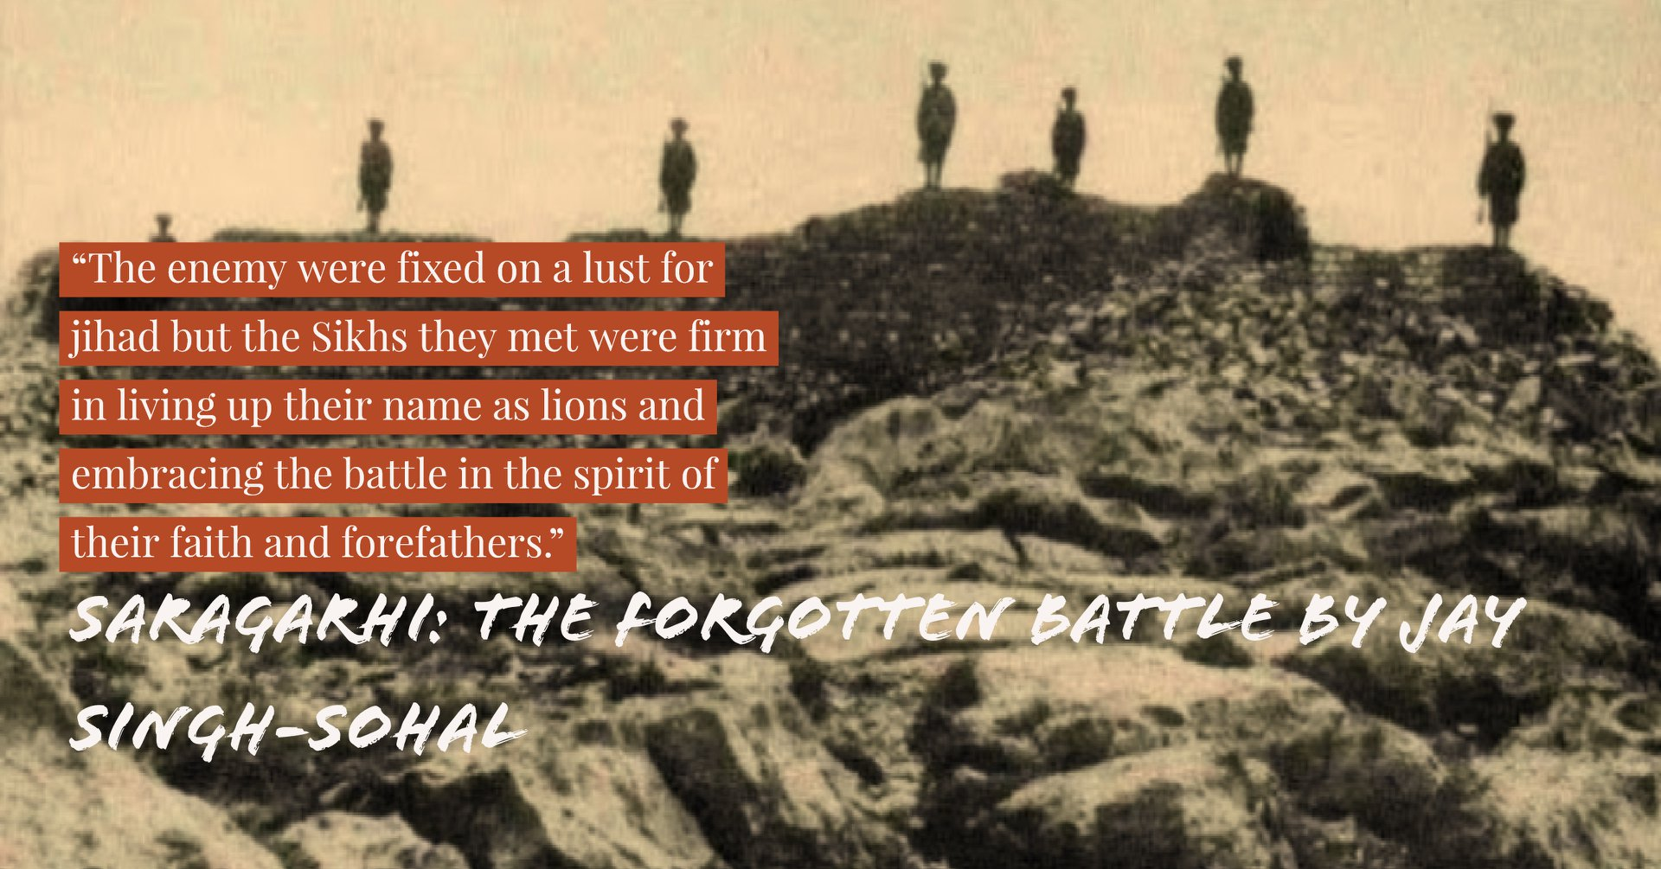
Bandginama
by
Sardar Raghbir Singh Bir

Slide 2
Ground Rules
1. Punctual attendance
2. The whole book/article of the month must be read
3. Come with an open mind
4. Share your learning and listen to others
5. Keep the discussion relevant
6. Respect each others’ confidentiality

Slide 3
Preface
Blockbuster hit “300” - King Leonidas vs Xerxes 480BC on par with Saragarhi
  Many similarities
Renowned last stands in history - why is Saragarhi forgotten?
  Alamo, Battle of Camaron, Rorke's Drift
Story full of emotional sentiment
  Several myths disproved - UNESCO, Applause of British House of Commons, French Legion
Methodical approach taken by author to obtain the facts of the story
Several achievements - book, film, annual Saragarhi day, presentations nationally and internationally

Slide 4
Introduction
Maps/Illustrations very good to paint a clear picture
Area largely inaccessible - dangerous region, close proximity to Afghanistan and Pakistani military
Belief system of Sikh evolved through battle?
Sikhs pride themselves on their independence - but swore allegiance to British?
The Indian Order of Merit

Slide 5
The “Great Game”
Anglo-Afghan war
  Internal politics were left to Amir of Afghanistan but Britain controlled foreign policy
Britain's forward policy - occupy frontier lands and keep presence in places inhabited by Pathans
  Sacrifice of Sikhs to establish outposts - Sepoy Diwan Singh and Sepoy Jaimal Singh
  Villages were entirely cleared away
Wires for field telegraphs cut by locals - therefore heliograph adopted

Slide 6
The Sikh Martial Spirit
Peaceful roots but by no means a pacifist movement
Seems to imply that Sikh Martial spirit was born out of the martyrdom of the 5th and 9th Guru
Mentions Chamkaur Sahib - interestingly did not choose to research this even greater last stand...

Slide 7
The Anglo-Sikh Relationship
British entered into a “friendship” with Maharaja Ranjit Singh
  Despite this Anglo-Sikh Wars were fought after his death; attributed to infighting
British decided to “harness the fighting power and determination of the Khalsa armies”.
  To keep them out of trouble in Punjab
  Deploy their fighting prowess against an old enemy, the Pathans
    “Fanaticism met with fanaticism”
Indian Mutinty in 1857
  In the Punjab all regiments stayed “loyal”
  Interesting theory of why the mutiny occured - “natural warrior”/martial race
Recruits encouraged to take Amrit - included an oath of loyalty to the crown
  “But for the army Sikhs would have merged into Hinduism”
  Low education background = better soliders easier to follow commands

Slide 8
The uprising
Jihad called for by Mullah of Handa
  As a result of kafirs having taken possession of Mussalman countries
  Afridi and Orakzai clan able to muster a force of 50,000
Bravery of Sikhs in abudance
  2 Sikhs lighting fire outside the fort to see enemy movements

Slide 9
The Last Stand
21 vs 10000; 1:476
  Camp follower Dadh ? local muslim
Martini Henry
  20 rounds per minute - comparable to AK47. Only 400 rounds per man. Danger of over-heating/jamming of cartridges
Offered safe passage by Pathans - rejected. Previous broken promises
Repulsed initial attack - two Pathans began to dig around tower; Seen by Gulistan - but unable to communicate effectively due to smokescreen
Haughton advance - only got 100 yards before it was too late
Ishar Singh led from the front - covered his men and engaged in hand to hand combat
Gurmukh Singh's suicide?

Slide 10
Gulistan and aftermath
Mrs Des Voeux, other women and children present
  Gave birth during seige - daughter names Violet Samana
Major Des Voeux learnt from the defects of the Saragarhi post
  Havildar Kala Singh volunteered to go out
    Later succumbed to wounds
  Halvildar Sunder Singh lept on own accord to support commrades under fire
  Sepoy Bela Singh to rescue missing members from party
Nurse present
Force of 34000 marched to subdue tribes once and for all

Slide 11
Recognition and Conclusion
36th Sikhs “Lavishly rewarded”
  33 soldiers recieved IOM
News published in Times
Recognition from HM's Government
Interesting letter from Sikh Sardars
  “Sikhs would die to a man in service of Her Most Gracious Majesty the Queen Empress”
Gratuity issued by Secretary of State for India
  24Rs for British, 12Rs for Native Soliders
Two monuments - Amritsar and Ferozepur
They fought because they had sworn an oath and were men of their word

