Slide 1


Slide 2
Ground Rules
1. Punctual attendance
2. The whole book/article of the month must be read
3. Come with an open mind
4. Share your learning and listen to others
5. Keep the discussion relevant
6. Respect each others’ confidentiality

Slide 3
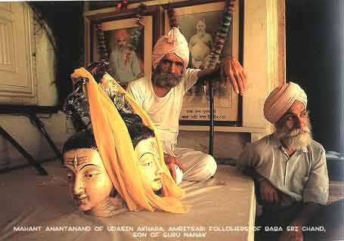
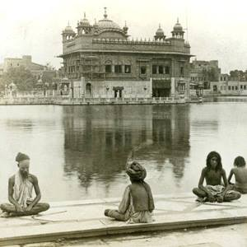
The Udasis in the Colonial Punjab by Kiranjeet Sandhu

Slide 4
Historical Background
Udasis
  Missionary tours of Guru Nanak Dev Ji
  Order of ascetics founded by Baba Sri Chand Ji
    To remain single, have no fixed abode and own no property
  Other sects excommunicated - only Udasis survived
    Gained prominence due to Masand corruption
Nomination over succession
  Baba Sri Chand claimed to be natural heir to gurgaddi
  Guru Angad Dev Ji moved from Kartarpur to Khadur Sahib to avoid confrontation
  Udasi belief that Guru Nanak Dev Ji started two gaddis

Slide 5
Historical Background - Baba Sri Chand Ji
Not much primary source material available
  Led most of life in seclusion - although sought out by various kings. Lived >100 years
  Many myths and fables
Studied extensively
  Instructed to studys vedas/shastras/other Indian holy books
Blessed by Guru Nanak Dev Ji with Naam
Travelled extensively
  Mecca, Nepal, Tibet amongst others
Composed Arta when Guru Nanak Dev Ji returned from 3rd Udasi
Given Udasi dress by Guru Nanak Dev Ji following 4th Udasi
Met with Guru Ram Das Ji, Guru Arjan Dev Ji and Guru Har Gobind Sahib Ji
  Reconciled to nomination of Guru
  Adopted Baba Gurditta Ji (who was married)

Slide 6
Let us sing the praises of Nanak, King of kings,
Emperor of both worlds.
The whole cosmos is His temple
Congregations sing sweet songs in His praise.
Millions of goddesses burn holy lamps in His honour
Millions of gods sing psalms in His praise.
Millions wash His lotus feet
The moon and sun illuminate Him with their radiance.
Masses of flowers are offering Him fragrance.
The True Master, the True Light, He is merciful to the poor.
The King of the Winds fans Him
While saints and sages meditate on His holiness.
He is universally accepted as the perfect Guru
The entire cosmos vibrates with his celestial song.
Bells ring out the tone -ONKAR-
Continuously illluminating the heavens.
He is one with God, Whose Name is Truth,
In Nanak's Name saints find their support.
Siri Chand, Nanak's son, declares,
"Nanak is unattainable, unfathomable, unshakeable, and pure."
Whoever sings Emperor Nanak's praises
Resides in heaven and achieves complete salvation.
Oh kind Master, protect those who seek your shelter
Oh Nanak! You are the saviour; we are just your children.

Slide 7
Historical Background - Baba Gurditta Ji
Recieved support and guidance from the Sikh Gurus
Founded seats of culture and centres
  Four Duans (smouldering hearths) - active centres of missionary work
    Rediscovered places visited by previous Gurus
    Learning Gurmukhi mandatory
  Six Bakshishes (lit bounty) and Ten Sub-Bakshishes
    Missonary assignment conferred on an individual by the Guru
Several famous individuals from Sikh history were Udasis
  Mihan Sahib, Bhai Pheru, Sutra Shah, Mahant Kirpal
Looked after Anandpur Sahib and Hazur Sahib
  Thwarted attempted of Gurbaksh Das to take over Anandpur

Slide 8
Udasi Establishments
Different words for establishment: Darbar, Gurudwara, Samadh, Dharamsala, Dera, Akhara
  250 centres during Sikh rule
    Liberal state patronage - 500 rupees/year.
      Brahmbuta Akhara - 18,000 rupees/year. 200 resident sadhus/70 musicians
  Religious, educational and cultural activites
    Sansrikht/Gurmukhi schools, medical services, provided clothes/food, works on science, morals and maths taught
  Food and shelter
  3 catergories - established by Udasi sadh, places assosiated with Sikh Gurus, centres connected with personalities assosiated with Guru Nanak Dev Ji.
After Annexation - change in political, social and religious affairs of the state.
  Deprived Sikhs of their acquired power and prestige
  Utilized state machinery to turn socio-religious organisations into their mould - funding offered with terms and conditions
    Reduction in Udasi numbers and change in their organisational structure

Slide 9
Udasi Establishments
Interesting comparision between Randhir Singh and Bramhanand views on the Udasi Samparda
? Udasis responsible for growth and development of towns/cities
Lost several legal cases to the Akaalis
  Seperated from Sikhs in the Gurudwara Act 1925
  Began to assert themselves as Hindus
  Many establishments lost in partition
Replacement of traditional education system with the English system

Slide 10
State Partonage
Grants frequently given by state
  Dharmarth - exempt from all obligations other than social responsibility
  Grantees expected to pray for state/enlist support for socio-political causes
  Enjoyed maximum revenue free grants in addition to Sodhis and Bedis
  200 estalishments receiving 80,000 rupees/year
Also obtained individual grants and prior to Sikh rule grants from Mughal state and Afghan chiefs
Grants for reciting SGGS and preparing copies
Partonage because of their popularity and this partonage increased their influence
  Cases of British continuing grants
  Mahant Custodians changed to Owners
    Many establishments turned to private houses closed to the public

Slide 11
Organisational Structure
Spiritual affilitation to orginial duan/bakshish
Akhara - largest organisation
  No fixed size
  Samadh
Darbars/Gurudwaras
Dharamsal
  Established in countryside
    Secular as well as religious purpose
Every centre was independent and had a Mahant (organiser of religious, financial and admin affairs)
  Chela, Gurbhai, Sadh, Granthis, Cooks, Musicians
  Different modes of running centre
  Only Mahant could nominate succesor
    Wait till last breath thereby ensuring dedication
    If dispute - panchayat

Slide 12
Organisational Structure
Own property; land, shops, houses, gardens and grooves
Aims and Objections of sect
Rules and regulations

Slide 13
Beliefs and Practises
Most information available from Udasi literature
  Majority written after 1920s
Great reverence for Guru Nanak and his followers
  Recite Japji Sahib, Rehras Sahib and Kirtan Sohila in addition to other bani
  Practice of keeping SGGS in establishments was common place
Subscribe to principle of gnosis (insight into real nature)
  Author suggests this in conflict with Sikhi?
  Gyan-Ratnavali written by Udasi
Object of Bhakti - supreme reality, necessity of Gyaan
Udasis did not conform to a single pattern
Believe in a seperate Gaddi from Guru Nanak Dev Ji to present Mahants
Worship five deities?
Believe in Vedas, Puranas, and the Shastras
Initiation ceremony
  Avoid women/gold
  Name change, ending with Brahm/Das
  Dress/Naked

Slide 14
Beliefs and Practises
Three types of Sadhu
  Several other denominations
Worship of Idols
Hatha-yoga
Dhuni - continous smouldering fire
Seva
Complete surrender to God - detachment to the world akin to a lotus flower
Gajo Ji Waheguru
Avoid meat, etoh and smoking

