Slide 1


Slide 2
Ground Rules
1. Punctual attendance
2. The whole book/article of the month must be read
3. Come with an open mind
4. Share your learning and listen to others
5. Keep the discussion relevant
6. Respect each others’ confidentiality

Slide 3
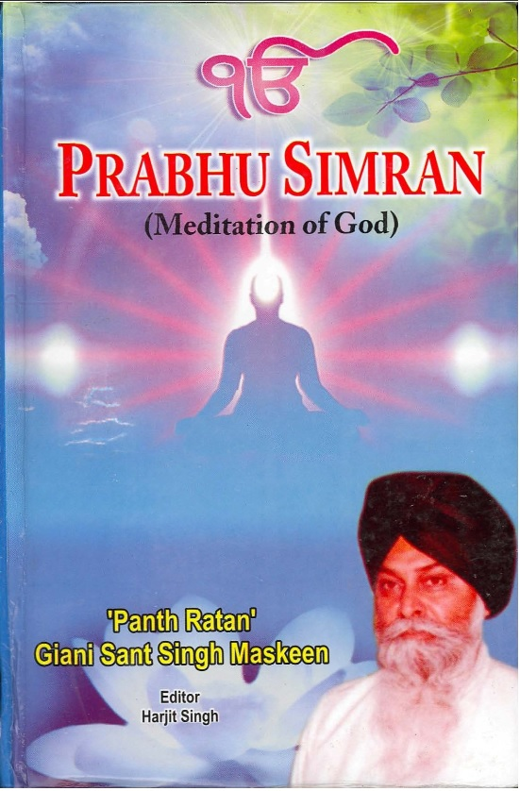
Prabhu Simran by Giani Sant Sing Maskeen

Slide 4
Preface
Themes:
The true name of God: Satnaam
Nirankaar, Niranjan, Agam, Agochar
Can’t meditate unless He blesses you – so the question is how to become blessed?
Power of sangat
Attending sangat is a form of meditation

Slide 5
Meditation of God - Method of Meditation
Themes:
Simran is the basis to reach the feet of God
Love-relationship (fond remembrance) but how can you love something you can’t perceive?
Importance of Sangat and collective meditation as well as individual meditation
Themes:
Uselessness of seeking advice from people without experience/qualification – results in doubt ? State (danger) of our current preachers
All answers are within Gurbani but you need to find them - dive deep/rational consideration
Thirst becomes contemplation which becomes automaticity – therefore no particular method, you have to have that ‘need’. Like people talking about food but not eating it. Are they really hungry?
Kabeer (the top most Bhagat) says, just do it!
Conjoining attention/consciousness to God’s name – through listening*

Slide 6
Individual Meditation - Silent Meditation
Themes:
Conversion of sound into spiritual power – but this is outwith our control
Easy to talk and recite, less easy to listen and absorb
Recognition of limitations - can feed self but no control over absorption/supreme bliss
If the mind is unhealthy the performed meditation does not bring supreme bliss
Themes:
Particular time for sowing seeds and particular time for meditation (early dawn)
  But should be done at all times
Concept of an ideal time – fourth pehar – like birds
  Dark to light externally and internaly
Sufi saint saying if you want to act like a king in the day time then act like a beggar at night.

Slide 7
Meditation with Rosary - Unrecited Meditation
Themes:
History of utilising objects to ease meditation – better to wander in one direction instead of in ten
Association of rosary with Islam
Kabeer used a rosary, it can help concentration. Then Kabeer says his rosary becomes his tongue.
  Flavour is the identification that the name has dwelt on the tongue
Themes:
Rare and lucky people achieve this uninterrupted unrecited meditation
  Zenith of meditation
  Spiritual bliss

Slide 8
Spiritual Power - Spiritual Sphere
Themes:
Concept that when a person does simran then everything is happy and that person becomes powerful
That person releases religious waves wherever he goes
The caution required when a person gains supernatural powers
  Saints of Sumair Hill
The travellers of this path mostly stop at this stage
Themes:
Spirit-dwelling planets
  Baigumpura; city without sorrow
The concept of a liberated soul
Irrelevance of concepts of time, mortality, food, oxygen

Slide 9
Various basis of Meditation - Silent Repetition of Holy Name
Themes:
Hindus gave prominence to water/bathing
Muslims gave prominence to earth/bowing down
Yogis/Jains/Parsis gave prominence to fire
Budha gave prominence to the sky
Guru Nanak gave prominence to air
  Fundamental part of sound
Themes:
Ajapa Jaap, Anhad Dhuni
The form of song and music as a manifestation of God
  Instruments developed for this purpose
Elevation of the shoe maker, weaver and cloth printer

Slide 10
Salvation - Liberated Soul
Themes:
Meditation results in salvation
We don’t see vices as fetters but as ornaments
The limitations of the law/politics
  Spider-web and Elephant
Singing praises is our need, not His – no difference to Him e.g the Sun
Themes:
Religion has become dead in human life as its benefits are reaped after death.
Religion is meant to break bonds - not apply them
Need to feel salvation whilst living
  Beyond life and death

Slide 11
Street Sludge and the Mind
Themes:
The thoughts of the mind has to pass through the perception organs
  Taste, smell, touch, sight, sound
Only by moving forward do you realise how much it drags you back
Just lie down in it! The power of supplication.
The importance of memory in human life
  Where we are today is because of memory
Samadhi is when excesses are removed and normality is achieved
If you remember another, they remember you “God is remembering me today, because I am remembering God” (Sufis)
Concept of thought transference as evidence of this
  The speed of thought
  Feeding hungry cranes
Does God remember everything? All are under his Vision.
Anecdote of student answering ‘Where is God not present’

Slide 12
Religious Rituals and Complete Success
Themes:
Defined by your job/professional title
Sikh Names as a means to remember God
Freud responsible for the hatred of parents
Marx responsible for the hatred of the rich
Gurmat says neither parents nor society is responsible for your suffering, blame your own actions.
Religious actions can just be a form of hypocrisy and do not lead closer to God.
Themes:
Not all trees become fruitful
Sick people find it hard to be well
The concept and need of blind faith in the beginning
Saints are called insane because their life style does not stand the test of the intellect of common man
Importance of being able to explain the spiritual world

Slide 13
Eulogy of God’s Name and Glimpse, Spiritual Knowledge, Character
Themes:
Name and knowledge are intricately linked
Man naming God as per attributes e.g. Timeless, Formless
Hari = thief
Recognition of the limitation of focusing on God’s name alone, but recognition that the concept of God is just as important
Themes:
Religion has become a form of hypocrisy
When the secrets of politicians are revealed then faith in politics is lost, when a religious and respectable person makes misdeeds, people lose faith in religion
Character without knowledge is nothing, knowledge without philosophy is nothing
Recite Naam to manifest character and conduct

Slide 14
Only Meditate (Essential Cause) and Union with Waheguru
Themes:
Emphasis on the importance of Naam
Meanings of Gurbani can be confusing until we are spiritually awakened
In religion, belief is required first, then perception comes afterwards.
Themes:
Surat
Beej mantar, mool mantar and gur mantar
Majority are not prepared to talk about Shabad Surat
A hungry person doesn’t ask how to eat, he just eats

