Slide 1


Slide 2
Ground Rules
1. Punctual attendance
2. The whole book/article of the month must be read
3. Come with an open mind
4. Share your learning and listen to others
5. Keep the discussion relevant
6. Respect each others’ confidentiality

Slide 3
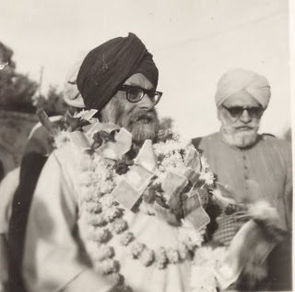
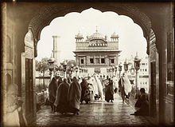
The Golden Temple: It's theopolitical status by Sirdar Kapur Singh

Slide 4
A meeting ground - A world-culture and world religion
  Two world-culture currents in conflict (since 11th century)
    Mutual contacts have left “monuments of bigotry and misunderstanding”
      Still mark the Indian scene
    Sikh prophets desired to level barriers and establish common spiritual ground
    The Golden Temple was intended to be a profound symbol of a universal culture
      Muslim divine lay the foundation stone
      Amritsar/Amrta/water as a symbol of the first manifestation

Slide 5
Sikh doctrine of Double Sovereignty
Akal Takht foundation (1609) and Guru Hargobind Sahib wearing the Miri Piri swords gave birth to the Sikh of Double Sovereignty.
  Modern ring and flavour
“a man of religion must always owe his primary allegiance to Truth and mortality, and he must never submit to the exclusive claim of the secular state to govern the bodies and minds of men”
  Whole of Sikh History is must be seen as an unfoldment of this Sikh attitude
    Sikh revolt against the Mughal State
    (Dharam Yudh Morcha) is also grounded in the same doctrinal conflict.
“The main substance of this doctrine is that any sovereign state which includes Sikh population and groups as citizens must never make the paranoia pretensions of almighty absolutism entailing the concept of total power, entitled to rule over the bodies and minds of men, in utter exclusiveness. Any state which lays such claims qua the Sikhs, shall automatically forfeit its moral right to demand allegiance of the, Sikhs and there is thus an internal antagonism between such a state and the collective community of the Sikhs, represented by the order of the Khalsa, and in this deadly duel the State shall never emerge out as finally victorious, for self-destruction is the fruit of the seed of nonlimitation, and the status and the prerogatives and the Khalsa are imprescriptible.”

Slide 6
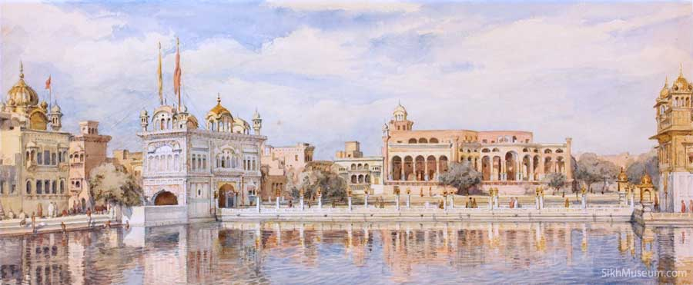
The principles of the Sikhs’ metalegal constitution
(1) they must he approached and dealt with at State level as a collective group and entity
(2) they must be governed impersonally, that is, through the rule of law and not by arbitrary will, and this self-limitation must further be circumscribed by the immemorial customs, long-established traditions and the facts of the history of the Sikhs.
Consistent with the modern concept of the pluralistic State

Slide 7
“When all means of peaceful persuasion fail, it is legitimate (for a man of religion) to move his hand to the hilt of the sword.”
Baba Banda Singh (1708) ordered to proceed to Punjab
  ‘due chastisement of the Mughal rulers, who have usurped the power that belongs to the people, condign punishment of those guilty of atrocities, destruction of their military bases and reestablishment of the freedom of the people.’
  State seal consistent with DS Doctrine:
    “We hereby place our impress of sovereignty upon both the worlds, the seen and the unseen.”
Collapse of Sikh political power in 1716
  Black out till 1721 - when the Golden Temple became the centre of activities
  Prior to this centres were the Nanaks
Never abdandoned two positions (despite occupation, destruction or being declared as outlaws):
  (1) the Golden Temple and its adjuncts are the hub of the Sikh world, not as a matter of concession by any worldly power, but as the inherent right of the Sikh people, sui generis and inalienable, and
  (2) there is no ultimate dichotomy in the true Sikh doctrine between this world and the next, the secular and the religious, the political and the spiritual.

Slide 8
Theo-political status
This position and this status of the Golden Temple is unique in the religious or political centres of world history.
  religious centre of the Sikhs
  capital of Sikh theocracy
    “no ordained priestly class...there can be no theocratic political state of the Sikhs in which the priests rule in the name of an invisible God.”
  it is the holiest of the holies of the faith
  it is the historical centre of the epiphany of Sikhism
It is not precisely the political capital of the Sikhs
  retains its theo-political status, which may be suppressed by political power, compromised by individuals or questioned by politicians, but which remains and never can be extinguished, for, it is sui generis and inalienable, and imprescriptible.
Many misunderstandings continuously arise concerning the use of the Golden Temple with its surrounding complex, for Political purposes’
  ? Never amongst Sikhs

Slide 9
Prehistoric Antiquity of Amritsar
Most extensive pre-classical civilisation of the world - Indus Valley civilisation
A natural water reservoir for thousands of years
  Amarkunda
  Well revered spot for the theomatic rishís of the vedãs
    ? Vedic hymns revealed to aryans just as those of SGGS
  Yogi at Santokhsar
  Buddhist monk-communities
    Founder of the Lamest Buddhism in Tibet took birth from a lotus floating on the sacred lake
  Surmises lack palpable root and material evidence

Slide 10
Autonomous political status
Offered in 1733 by Mughal State + (?1947 by Mr. Jinnah of the Muslim League)
  accepted with the reservation that, “the Khalsa meant to rule freely, cannot accept permanently, a subordinate position”
  Developments took place within the Golden Temple complex
    Following this established five military cantonments
      Why was this doomed to fail?
“Grass-eaters” attack Nadir Shah - interesting conversation between Nadir Shah and Zakariya Khan
Sikhs Avenge Profanity of the Golden Temple
  Invaders knew of it's theo-political status
    Massa Ranghar
    Lakhpatrai
    Nadir Shah
  Combined forces of the Marathas and the Sikhs - drive of Afghan invaders
    Raghunath Rao and Malhar Rao Holkar
Even during the Sikh Raj retained its theo-political autonomy and the writ of the Maharaja Ranilt Singh did not run within its precincts.

Slide 11
Foreign Influence
British fiction and a device
  Come to Asia in fulfilment of a prophecy of the Guru
  Allies of the Khalsa
  Government-appointed Sikh manager
  Sought to use the Golden Temple in approval of the action of General Dyer
    Gave birth to the SGPC (1927)
Indian Government's repeated attempts to obtain control of the Golden Temple
  Sikhs, in some way, transgress by employing the Golden Temple and its precincts for the purpose, for which they have always been employed, and for which they were intended from the very beginning
A religious life must be lived and practised in the socio-political context

